Slide 1


Data League
Gianluca Coletta’s Project
12 December – 2023
© 2023 APSIA– Tous droits réservés

Slide 2

Introduction
© 2023 APSIA– Tous droits réservés

Slide 3

The context
Teleperformance is a France multinational company. They provide services for debt collection, telemarketing, customer relationship management, content moderation, and communication.
They are a publicly traded company, and they are required to furnish financial statements monthly.
So, thousands of transactions are recorded in Microsoft Dynamics 365 by each sub-company every month.
© 2023 APSIA– Tous droits réservés

Slide 4

Aim of the project
Perform data analysis in Power BI to identify, for example, the most impactful financial closing activities, or analyze monthly trends in transaction recording, or which sub-company impact the most.
Conducting a Forecast for enhanced financial closing efficiency and timely issue prevention.
Finally, integrate an artificial intelligence through Azure AI Studio to leverage the full potential of the data.
© 2023 APSIA– Tous droits réservés

Slide 5
What I’ve done so far
© 2023 APSIA– Tous droits réservés

Slide 6
Main activities
Preliminary study regarding forecasting and time series to understand how they can be exploited.
Preprocessing and extraction of data of interest to carry out the project.
Identification and study of key monthly financial closing activities.
For each transaction, the referenced closing activity was identified using information from their SQL Server Database.
Training a machine learning algorithm to categorize difficult-to-classify transactions.
© 2023 APSIA– Tous droits réservés

Slide 7
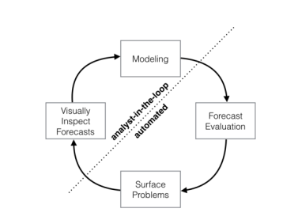
Forecasting and time series
Forecasting uses historical data to predict future trends. Time series analysis focuses on patterns within data collected over time, aiding predictions and decision-making.
Analyst-in-the-loop modeling is an approach where human analysts actively participate in the model-building process. This collaborative method involves human expertise to refine, validate, and enhance machine learning models, ensuring a more accurate and reliable outcome.
© 2023 APSIA– Tous droits réservés

Slide 8
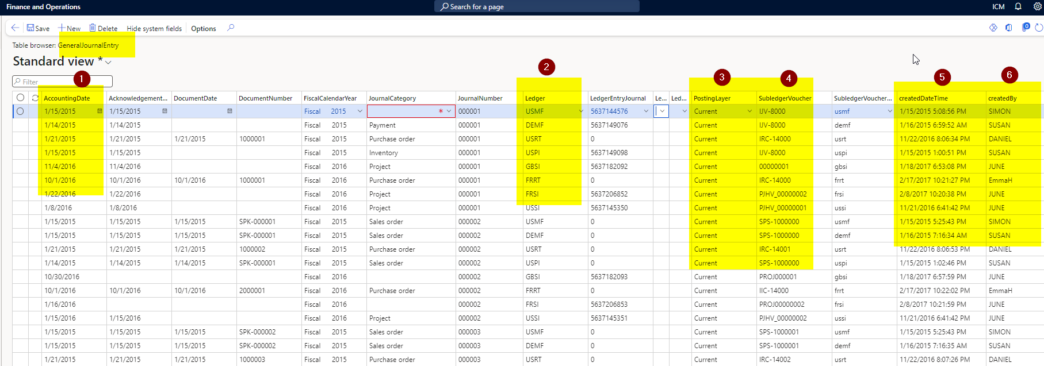
Preprocessing and data extraction (1/3)
The main tables that are affected during financial closing are GeneralJournalEntry and GeneralJournalAccountEntry.
General Journal Entry
© 2023 APSIA– Tous droits réservés

Slide 9
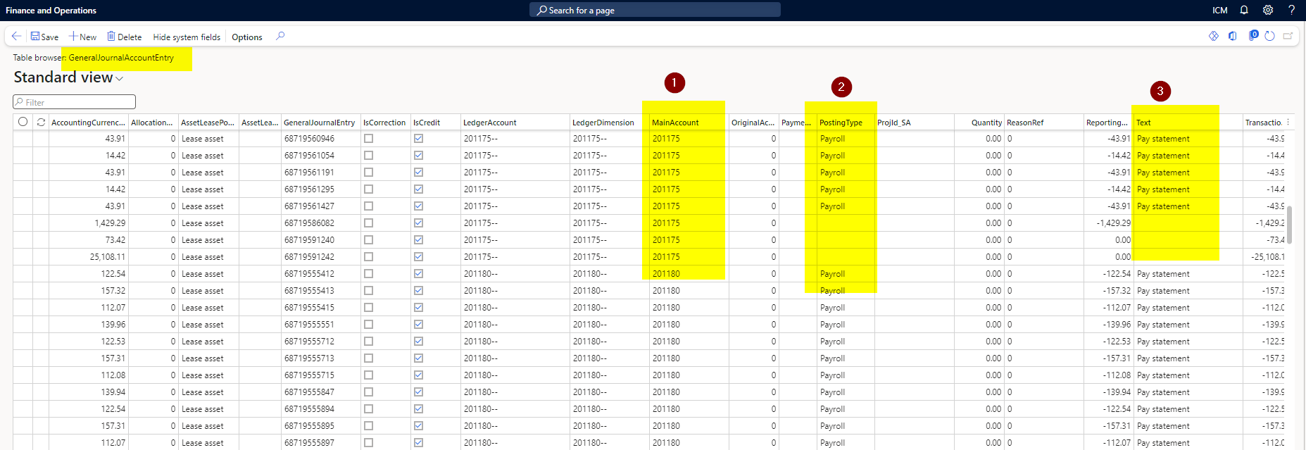
Preprocessing and data extraction (2/3)
The main tables that are affected during financial closing are GeneralJournalEntry and GeneralJournalAccountEntry.
General Journal Account Entry
© 2023 APSIA– Tous droits réservés

Slide 10
Preprocessing and data extraction (3/3)
In addition, for each transaction, additional useful information was obtained from other tables: like the GroupChartOfAccounts name, PostingType, JournalCategory, Journal Type, etc.
So, for each transaction we have the following fields:
GeneralJournalAccountEntryId
AccountingDate
CreatedDateTime
LedgerDimension
GroupChartOfAccountsValue
GroupChartOfAccountsName
Ledger
PostingLayer
SubledgerVoucher
SubledgerVoucherDataAreaId
JournalCategory
PostingTypeLabel
PostingTypeValue
MainAccount
Text
JournalTypeLabel
NumOfLines
CountLedgerJournal
TransactionCurrencyAmount
TransactionCurrencyCode
ClosingActivityDescription
ClosingActivityId
© 2023 APSIA– Tous droits réservés

Slide 11

Key financial closing activities
Post vendor invoice
Post and settle all payments
Run Currency revaluation
Post sales invoices
Post and settle all received payments
Perform Bank reconciliation
Post all acquisitions or adjustments if require
Post all sales/scrap of assets
Run depreciation for the month
Declare tax
Post all adjustments in ledger
Post all allocations
Post all Accruals if require
Run fiscal year close
© 2023 APSIA– Tous droits réservés

Slide 12
Assignment
closing activity
to transactions (1/2)
To assign a closing activity to a transaction we mainly focused on two fields: the PostingType and the JournalCategory.
For example, if the JournalCategory field is equal to LedgerJournal and the PostingType is equal to Vendor the assigned activity will be Post vendor invoice.
© 2023 APSIA– Tous droits réservés

Slide 13

Assignment
closing activity
to transactions (2/2)
For some pairs of PostingType and JournalCategory there are ambiguities about the assignment of the closing activity: nearly 3 million rows (about 3% of the total) are affected.
So I am trying to develop a machine learning algorithm using data with right activity to assign the closing activity for these transactions.
© 2023 APSIA– Tous droits réservés

Slide 14

Advices and ideas
© 2023 APSIA– Tous droits réservés

Slide 15
Thanks for your attention
© 2023 APSIA– Tous droits réservés

